Slide 1
Design for Change Patterns & Principles
Dr. Javaria Imtiaz,
Mr. Basharat Hussain,
Mr. Majid Hussain

Slide 2
Content
Observer
Adaptor
Strategy

Slide 3
"Gang of Four" design patterns describing how to solve recurring design challenges in order to design flexible and reusable object-oriented software, i.e. objects which are easier to implement, change, test, and reuse

Slide 4
Strategy Pattern
Intent:
Strategy is a behavioral design pattern that lets you define a family of algorithms, put each of them into a separate class, and make their objects interchangeable.

Slide 5
Problem
One day you decided to create a navigation app for casual travelers. The app was centered around a beautiful map which helped users quickly orient themselves in any city.
One of the most requested features for the app was automatic route planning. A user should be able to enter an address and see the fastest route to that destination displayed on the map.
The first version of the app could only build the routes over roads. People who traveled by car were bursting with joy. But apparently, not everybody likes to drive on their vacation. So with the next update, you added an option to build walking routes. Right after that, you added another option to let people use public transport in their routes.

Slide 6
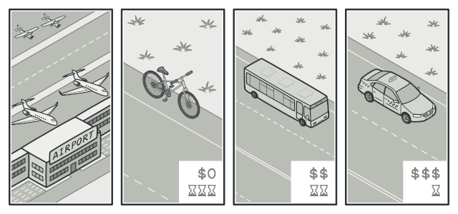
Various strategies for getting to the airport.

Slide 7
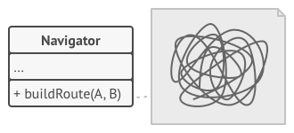
Cont..
However, that was only the beginning. Later you planned to add route building for cyclists. And even later, another option for building routes through all of a city’s tourist attractions.
The code of the navigator became bloated.

Slide 8
Cont..
From a business perspective the app was a success, the technical part caused many headaches.
Each time you added a new routing algorithm, the main class of the navigator doubled in size. At some point, the beast became too hard to maintain.
Any change to one of the algorithms, whether it was a simple bug fix or a slight adjustment of the street score, affected the whole class, increasing the chance of creating an error in already-working code.

Slide 9
Solution
The Strategy pattern suggests that you take a class that does something specific in a lot of different ways and extract all of these algorithms into separate classes called strategies.
The original class, called context, must have a field for storing a reference to one of the strategies. The context delegates the work to a linked strategy object instead of executing it on its own.
The context isn’t responsible for selecting an appropriate algorithm for the job. Instead, the client passes the desired strategy to the context. In fact, the context doesn’t know much about strategies. It works with all strategies through the same generic interface, which only exposes a single method for triggering the algorithm encapsulated within the selected strategy.

Slide 10
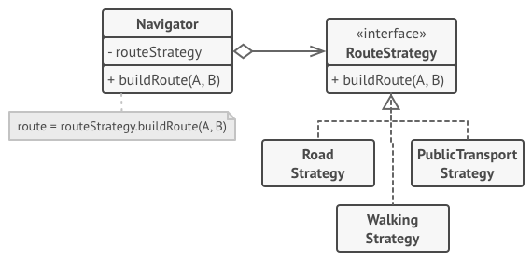
Cont..
This way the context becomes independent of concrete strategies, so you can add new algorithms or modify existing ones without changing the code of the context or other strategies.
Route planning strategies.

Slide 11
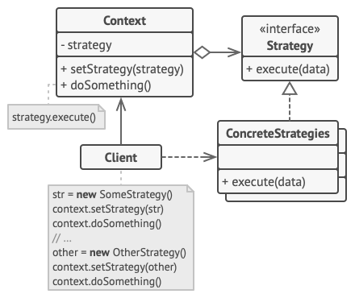
UML for Strategy pattern
The Context maintains a reference to one of the concrete strategies and communicates with this object only via the strategy interface
The Strategy interface is common to all concrete strategies. It declares a method the context uses to execute a strategy.
Concrete Strategies implement different variations of an algorithm the context uses.
The Client creates a specific strategy object and passes it to the context. The context exposes a setter which lets clients replace the strategy associated with the context at runtime.

Slide 12
Implementation In JAVA

Slide 13
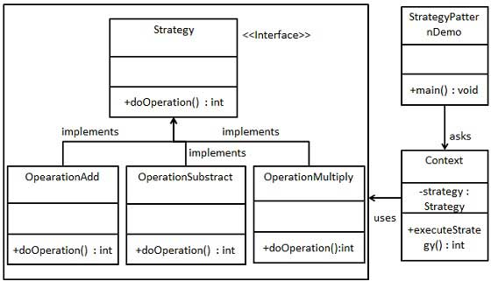
Example

Slide 14
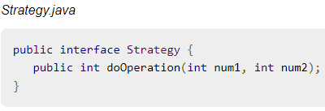
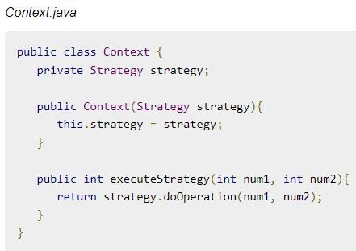
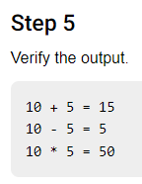
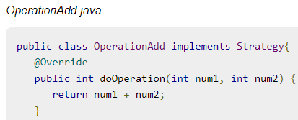
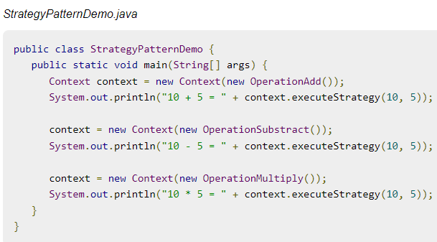
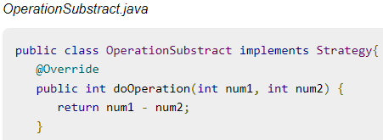
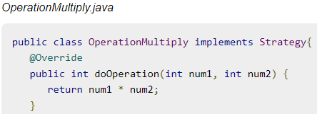

Slide 15
Difference between Factory and Strategy
The Factory Pattern.
Create concrete instances only. Different arguments may result in different objects. It depends on the logic etc.
The Strategy Pattern.
Encapsulate the algorithm ( steps ) to perform an action. So you can change the strategy and use another algorithm.

Slide 16
Observer Pattern
The Observer Design Pattern maintains one-to-many dependency between Subject (Observable) and its dependents (Observer) in such a way that whenever state of Subject changes, its dependents get notified.
The Observer Design Pattern is a design pattern in which an object, called the subject, maintains a list of its dependents, called observers, and notifies them automatically of any state changes, usually by calling one of their methods.
The Observer Design Pattern is used when we like to have notification upon changes in the objects state.
The Observer Design Pattern is one of twenty-three well known Gang of Four design patterns that defines an one-to-many dependency objects so that when one object changes state, all of its dependents get notified and updated automatically.

Slide 17
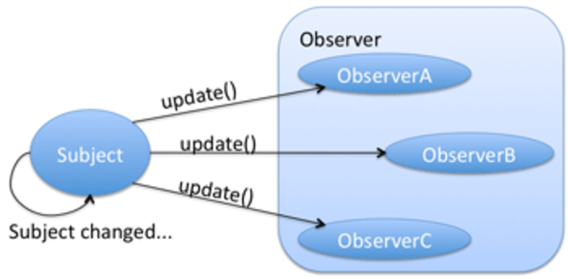
Real world example of observer pattern
A real world example of observer pattern can be any social media platform such as Facebook or twitter. When a person updates his status – all his followers gets the notification.
A follower can follow or unfollow another person at any point of time. Once unfollowed, person will not get the notifications from subject in future.

Slide 18
Subject & Observer
Subject
the object which will frequently change its state and upon which other objects depend
Observer
the object which depends on a subject and updates according to its subject's state.

Slide 19
Observer Pattern - UML
observers
Subject
Observer
Attach(Observer)
Detach(Observer) Notify()
Update()
for all o in
observers {
o -> Update()}
ConcreteObserver
Update()
observerState =
subject->GetState()
subject
ConcreteSubject
observerState
SetState()
GetState()
return subjectState
subjectState
Notes:
Related Patters:
Mediator – an object in the middle intercepts all update requests and broadcasts them to other objects
Singleton – A “single” subject object instance can be implemented with a Singleton
Decorator – an intermediate observer can be viewed as a subject’s decorator
Proxy – observer do not interact directly with subject and can hide the way the subject is acceded

Slide 20
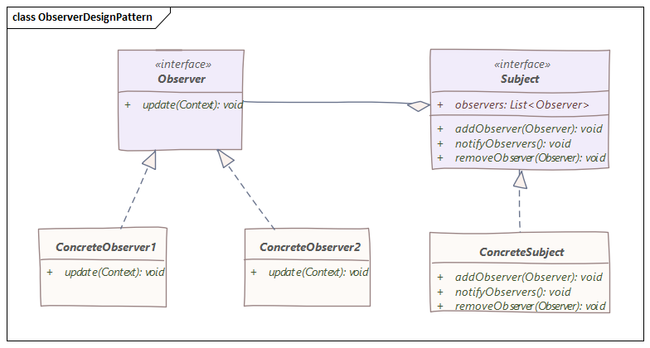

Slide 21
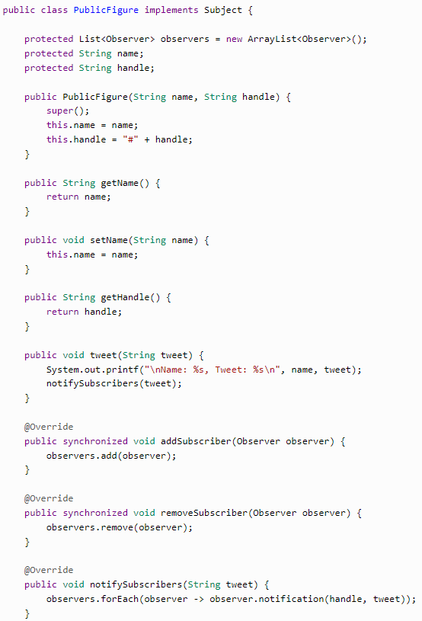
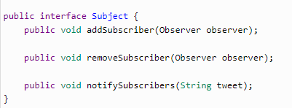

Suppose there are some public figures like politicians or celebrities for which there are some followers. Whenever these public figures do any tweet, there registered followers get the notification on that.
Notes:
Tweet Notification Example using Observer Design Pattern

Slide 22
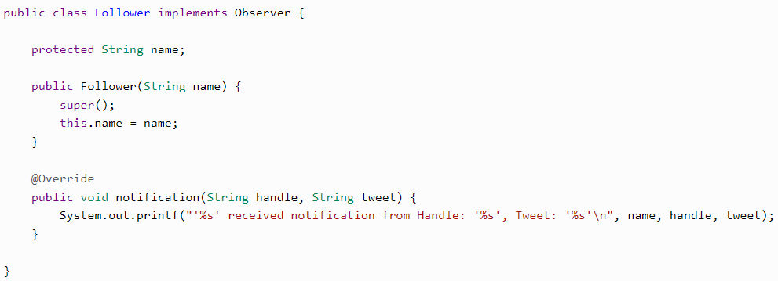

Slide 23
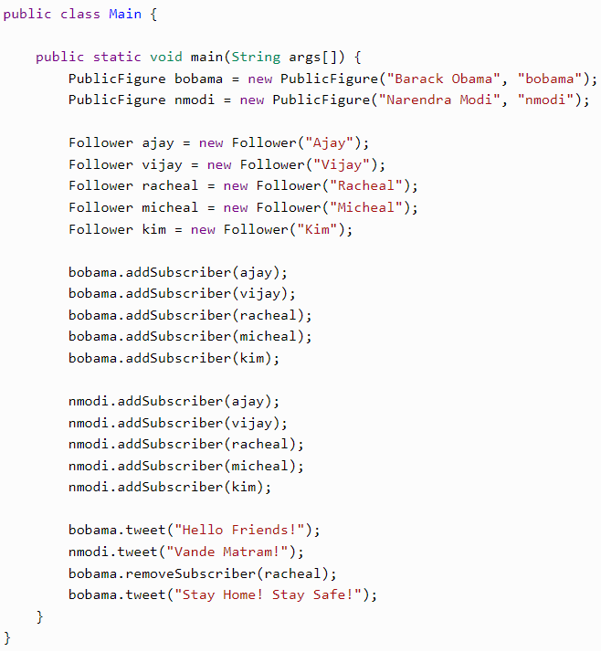

Slide 24
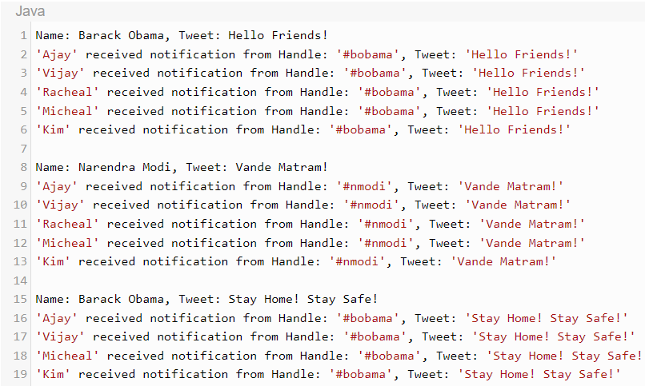

Slide 25
Adapter
Adapter pattern works as a bridge between two incompatible interfaces.
This type of design pattern comes under structural pattern as this pattern combines the capability of two independent interfaces.
This pattern involves a single class which is responsible to join functionalities of independent or incompatible interfaces.
It can convert the interface of a class, to make it compatible with a client who is expecting a different interface, without changing the source code of the class.
The Adapter Pattern is also known as Wrapper.

Slide 26
Examples
Like we have a card reader adapter which acts as a link between our computer and memory card.
Another example will be a charging adapter that acts as a link between a device and the charging port.

Slide 27
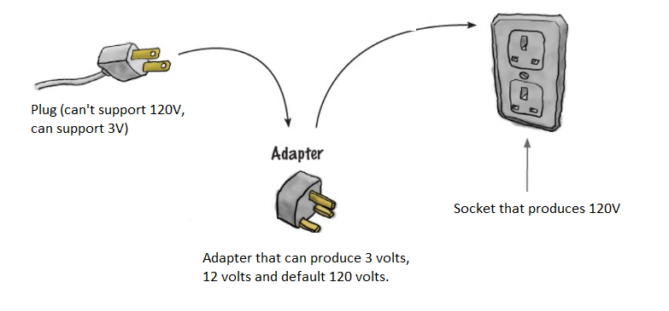
Examples

Slide 28
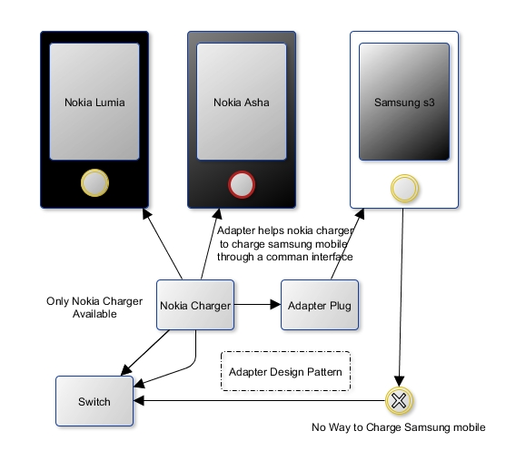
Examples

Slide 29
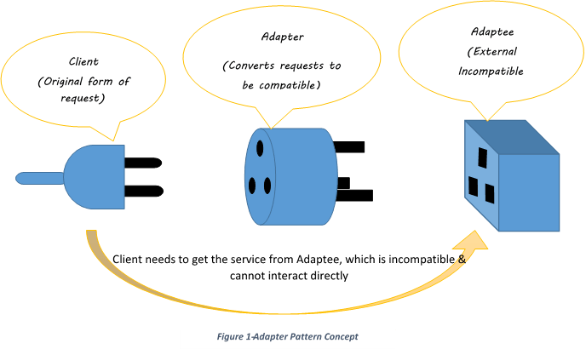
Examples

Slide 30
Problem
Let us say we have an image showing application that can show only jpeg images, but we want to use an advanced image application that is capable of showing (.png) and (.jpg) files too. So we can use Adapter Design Pattern here to act as a link between these two different interfaces.

Slide 31
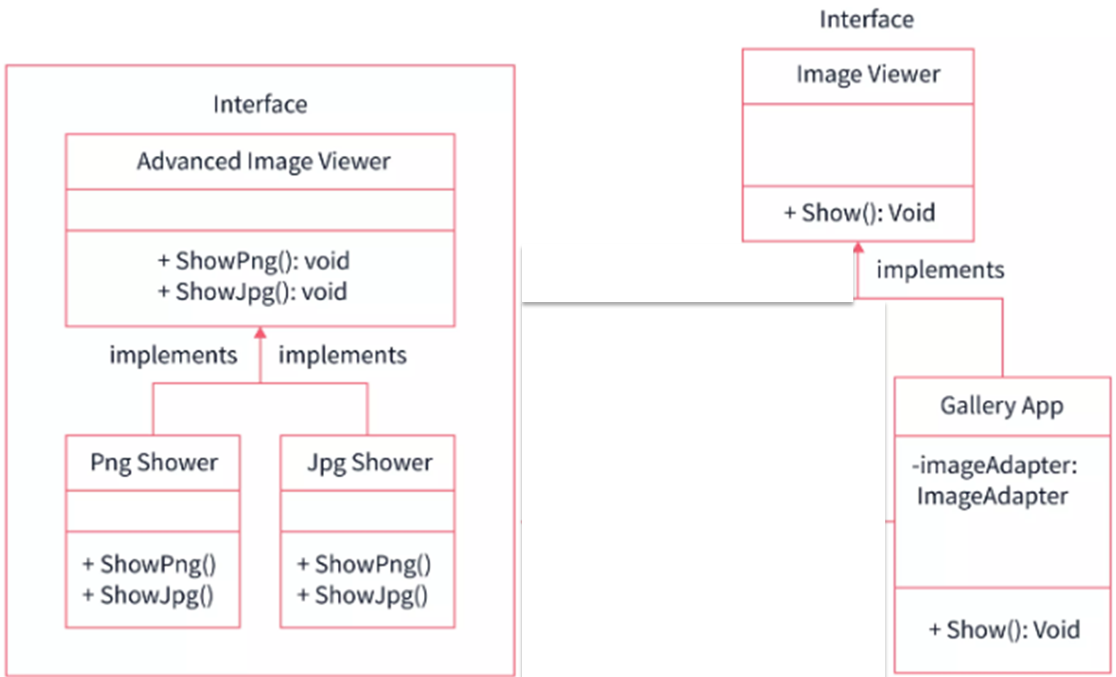
AdvancedImageViewer and concrete classes implementing this interface.These classes can show png and jpg files by default.
We have an ImageViewer interface and a concrete class named GalleryApp which is implementing the ImageViewer interface. GalleryApp can show jpeg files by default.
Now we want our GalleryApp class to be able to show png and jpg files without changing the source code of the ImageViewer interface.

Slide 32
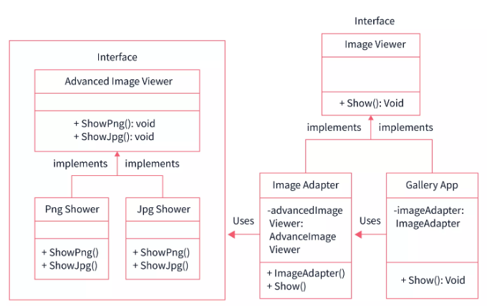
So we can use an Adapter design pattern to achieve this. We will create a ImageAdapter which implements ImageViewer and uses a AdvancedImageViewer object to show the desired image format.
Our Gallery application will use the ImageAdapter and simply pass the desired image format without worrying about which class can show what image format.

Slide 33
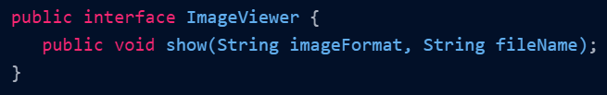
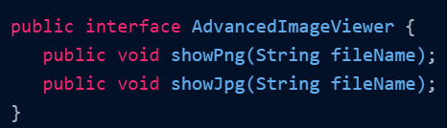
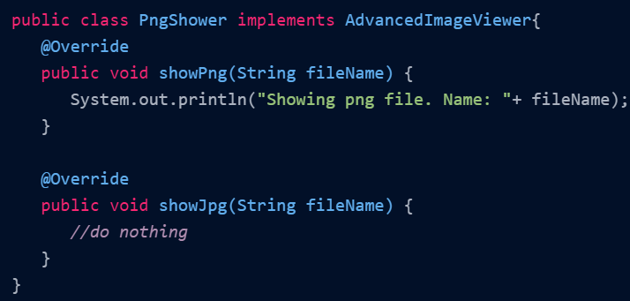
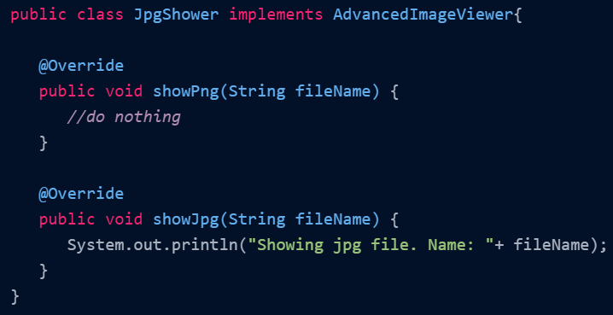

Slide 34
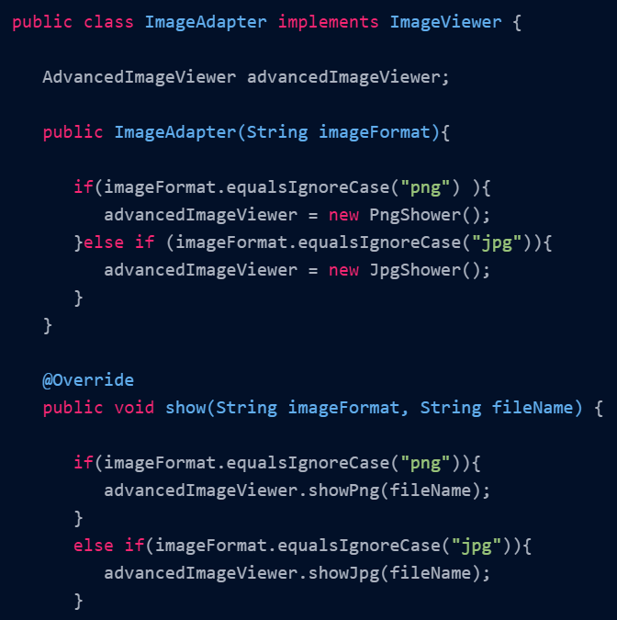

Slide 35
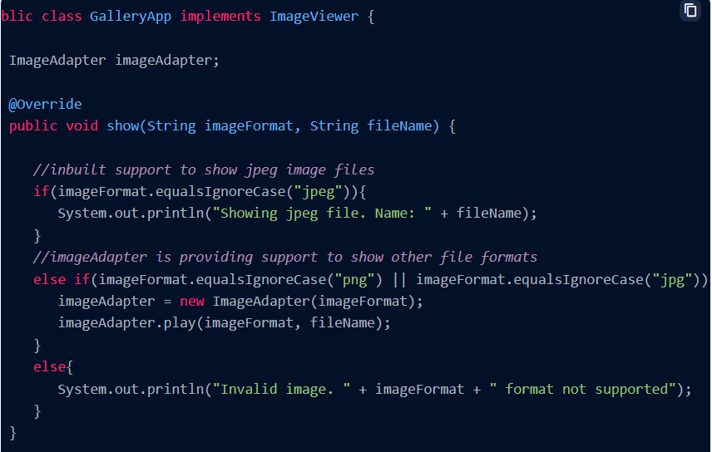

Slide 36
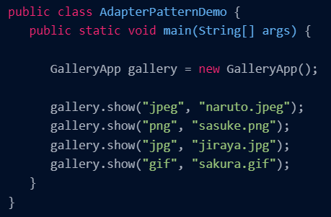
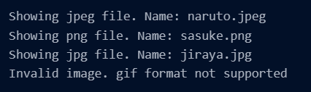

Slide 37
Benefits
Separation of Concern: We can separate the interface or data conversion code from the main business logic part of the code.
Independence of Code: We can implement and use the various adapters without breaking the existing client or main code.

